Slide 1
Industry Recommended Certifications

Slide 2
Functional domain specific certifications
Certified International Payment Systems Professional (CIPSPTM)
Certified Payment Messaging Expert (CPMETM)
Certified Payment Processing Specialist (CPPSTM)
Certified Payment Messaging Expert (CPMETM)
Certificate Course In Anti-Money Laundering (For IT Professionals)
Fundamentals Of ISO20022 And SWIFT Standards MX For Payments

Slide 3
Process and methodology specific certifications
UXQB® CPUX Foundation Level
ISAQB® Software Architecture - Foundation Level
Professional Scrum Developer certification – Scrum

Slide 4
Software testing specific certifications
QAI
CAST – Certified Associate In Software Testing
CSTE – (Certified Software Test Engineer)
Certified Associate in Software Quality (CASQ)
Certified Software Quality Analyst (CSQA)
Certified Manager of Software Quality (CMSQ)
Certified Associate in Software Testing (CAST)
Certified Software Tester (CSTE)
Certified Manager of Software Testing (CMST)
Certified Software Project Manager (CSPM)
Certified Associate Business Analyst (CABA)
Certified Software Business Analyst (CSBA)
Certified Software Process Engineer (CSPE)
Certified Quantitative Software Process Engineer (CQSPE)

Slide 5
Software testing specific certifications
IIST (International Institute for Software Testing)
Certified Agile Software Test Professional Practitioner Level (CASTP-P)
Certified Agile Software Test Professional Master Level (CASTP-M)
Certified Software Test Automation Specialist
Certified Software Test Automation Architect

Slide 6
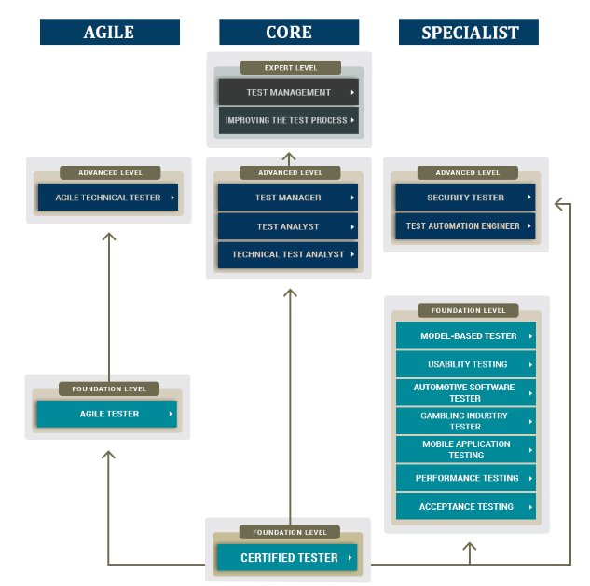
Software testing specific certifications - ISTQB

Slide 7
Technical Certifications
Java
Certified Agile Software Test Professional Practitioner Level (CASTP-P)
Certified Agile Software Test Professional Master Level (CASTP-M)
Certified Software Test Automation Specialist
Certified Software Test Automation Architect
Spring
Spring Certified Professional
Kafka
Certified Developer for Apache Kafka
Confluent Certified Administrator
Elastic
Elastic Certified Engineer
Elastic Certified Analyst
Elastic Certified Observability Engineer

Slide 8
Technical Certifications
DevOps
Certified Kubernetes Administrator (CKA)
Certified Kubernetes Application Developer (CKAD)
Cassandra
Administrator Certification
Developer Certification
Azure Certification Path
Exam AZ-900: Microsoft Azure Fundamentals
Exam AZ-103: Microsoft Azure Administrator
Exam AZ-203: Developing Solutions for Microsoft Azure
Microsoft Certified: Azure Solutions Architect Expert

Slide 9
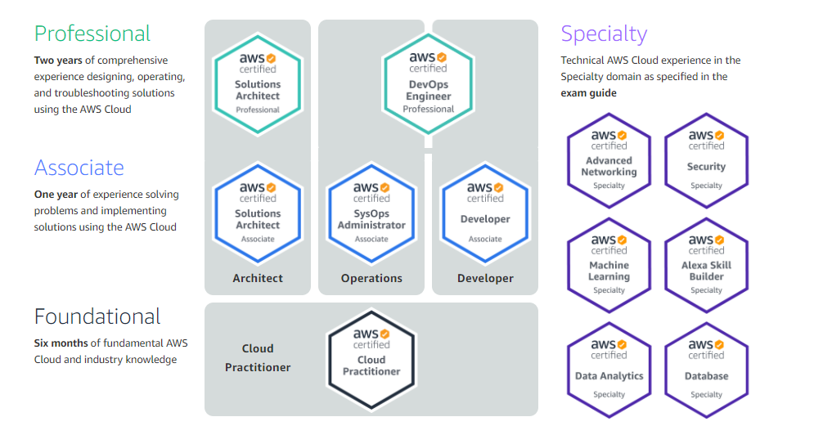
Technical Certifications - AWS Certification Path

Slide 10
Technical Certifications – Important links
Microsoft certified - https://docs.microsoft.com/en-us/learn/certifications/browse/?expanded=dotnet
Oracle certified - https://education.oracle.com/oracle-certification-exams-list?regularExams / https://education.oracle.com/en/certification
RHEL certified - https://www.redhat.com/en/services/certifications?type=technology
Google certified - https://developers.google.com/certification
IBM certified - https://www.ibm.com/certify/certs
AWS certified - https://aws.amazon.com/training/learning-paths/#Role-Based_Paths
C/C++ - https://india.pearsonvue.com/Clients/CPP-Institute.aspx - Generally these exams are held in test centers but due to Covid-19 they are now held online as well.
Cognixia - https://www.cognixia.com/ - India members can contact 7227993338 (Harsh) or 7987201930 (Pallavi) for assistance on certifications, course fees and other details.

